Slide 1

MAJOR PROJECT 2021-2022 PHASE -1 PRESENTATION – 2
SCHOOL OF COMPUTER SCIENCE AND ENGINEERING

Slide 2
TOPIC: GENERATIVE ADVERSARIAL NETWORK FOR IDENTIFICATION OF CANCER SUBTYPES

Slide 3
GROUP NUMBER: d3
Name of the Guide: Prof. Nimrita Koul
Group Members:
Dileep Kumar Reddy J K R18CS511
Soham Kishor Misal R17CS404
Veerendra Patil P R18CS535
Semester – 7 Section - D
School of Computer Science and Engineering

Slide 4
Agenda
ABSTRACT
INTRODUCTION
LITERATURE SURVEY
OBJECTIVES
METHODOLOGY
MODULES
WORK PROGRESS & PLAN
CONCLUSIONS
REFERENCES

Slide 5
abstract
Cancer has been characterized as a heterogeneous disease consisting of several subtypes, prediction of these subtypes is vital for cancer diagnosis and therapy.
Our aim is to build a deep learning model using Generative Adversarial Networks (GANs) on the TCGA dataset to detect the types and subtypes of cancer.

Slide 6
Introduction
Cancer is the second leading cause of death worldwide, an average of one in six deaths is due to cancer. Considerable research efforts have been devoted to cancer diagnosis and treatment techniques to lessen its impact on human health.
Deep learning (DL), a branch of Artificial Intelligence, is a family of multi-layer neural network models that excel at the problem of learning from big data.

Slide 7
Literature survey
In recent years, the analysis of gene-expression data is gaining a growing interest in the area of precision medicine [2]
In clinical areas the appearance of high-throughput sequencing technology called RNA-Seq has provided physicians with gene-expression data that allow for precise diagnosis and determination of the patient’s state from a molecular point of view [4]
In the last decade, many Machine Learning approaches have been adapted to deal with cancer diagnosis and prediction based on gene-expression data. Prior knowledge has been used to select specific genes conforming to gene signatures that can be used to successfully predict certain clinical outcomes. [5]

Slide 8
objectives
Study of the RNA Sequence dataset
Data Pre-Processing
Feature Selection
Model Building
Testing and Deployment
Notes:
Contains over 10,000 values

Slide 9
methodology
The proposed method is a Generative Adversarial Network (GAN)
GAN is a class of machine learning frameworks,
it consists of two neural networks, discriminator and generator,
these neural networks contest with each other in the form of a zero-sum
game, where one agent’s gain is another agent’s loss.
The generative network generates candidates (images) while the
discriminative network evaluates them.

Slide 10
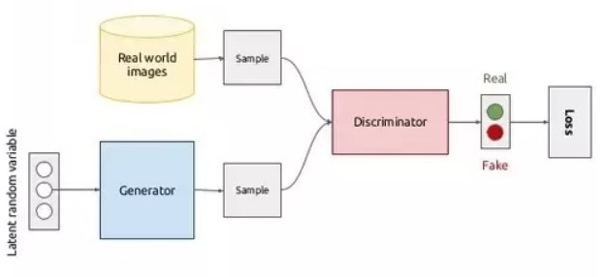
Working of GAN
The generator takes in a vector of random variables, Z, and produces an image, I
The discriminator takes in the image I and produces a single output, p, deciding the probability if the image is real or fake When: p=1, the discriminator believes that the image is real, and p=0, the discriminator believes that the image is fake

Slide 11
modules
Data Pre-Processing:
Methods – Normalization, Standardization and Missing Value Imputation
Conversion of RNA-Sequence dataset into images
Feature Selection: (Recursive Feature Elimination, F-Test)
Model Building & Testing:
Deployment
Notes:
F-Test
It is useful in feature selection as we get to know the significance of each feature in improving the model.
//It is a statistical test used to compare between models and check if the difference is significant between the model.
F-Test does a hypothesis testing on model X and Y
where X is a model created by just a constant and
Y is the model created by a constant and a feature.
The least square errors in both the models are compared and checks if the difference in errors between model X and Y are significant or introduced by chance.

Slide 12
workflow
Duration | Project Flow
1st week of February | Data Pre-Processing
3rd week of February | Feature Selection
1st week of March | Model Development
4th week of March | Model testing
2nd week of April | Model Deployment

Slide 13
conclusions
The Generative Adversarial Network (GAN) based cancer subtype prediction model will help medical service providers save time and give precise results.

Slide 14
references
1. Li, Y., Kang, K., Krahn, J. M., Croutwater, N., Lee, K., Umbach, D. M., & Li, L. (2017). A comprehensive genomic pan-cancer classification using The Cancer Genome Atlas gene expression data. BMC genomics, 18(1), 1-13.
2. Albaradei, S., Napolitano, F., Thafar, M. A., Gojobori, T., Essack, M., & Gao, X. (2021). MetaCancer: a deep learning-based pan-cancer metastasis prediction model developed using multi-omics data. Computational and Structural Biotechnology Journal, 19, 4404-4411.
3. Rocha, D., García, I. A., González Montoro, A., Llera, A., Prato, L., Girotti, M. R., & Fernández, E. A. (2021). Pan-Cancer Molecular Patterns and Biological Implications Associated with a Tumor-Specific Molecular Signature. Cells, 10(1), 45.
4. López-García, G., Jerez, J. M., Franco, L., & Veredas, F. J. (2020). Transfer learning with convolutional neural networks for cancer survival prediction using gene-expression data. PloS one, 15(3), e0230536.
5. Chaudhari, P., Agrawal, H., & Kotecha, K. (2020). Data augmentation using MG-GAN for improved cancer classification on gene expression data. Soft Computing, 24(15), 11381-11391.
6. Kim, B. H., Yu, K., & Lee, P. C. (2020). Cancer classification of single-cell gene expression data by neural network. Bioinformatics, 36(5), 1360-1366.

Slide 15
THANK YOU

